Slide 1
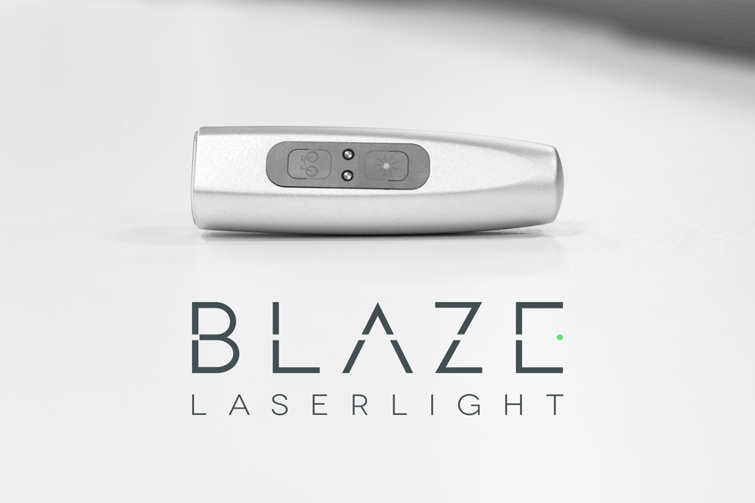
Blaze

Slide 2

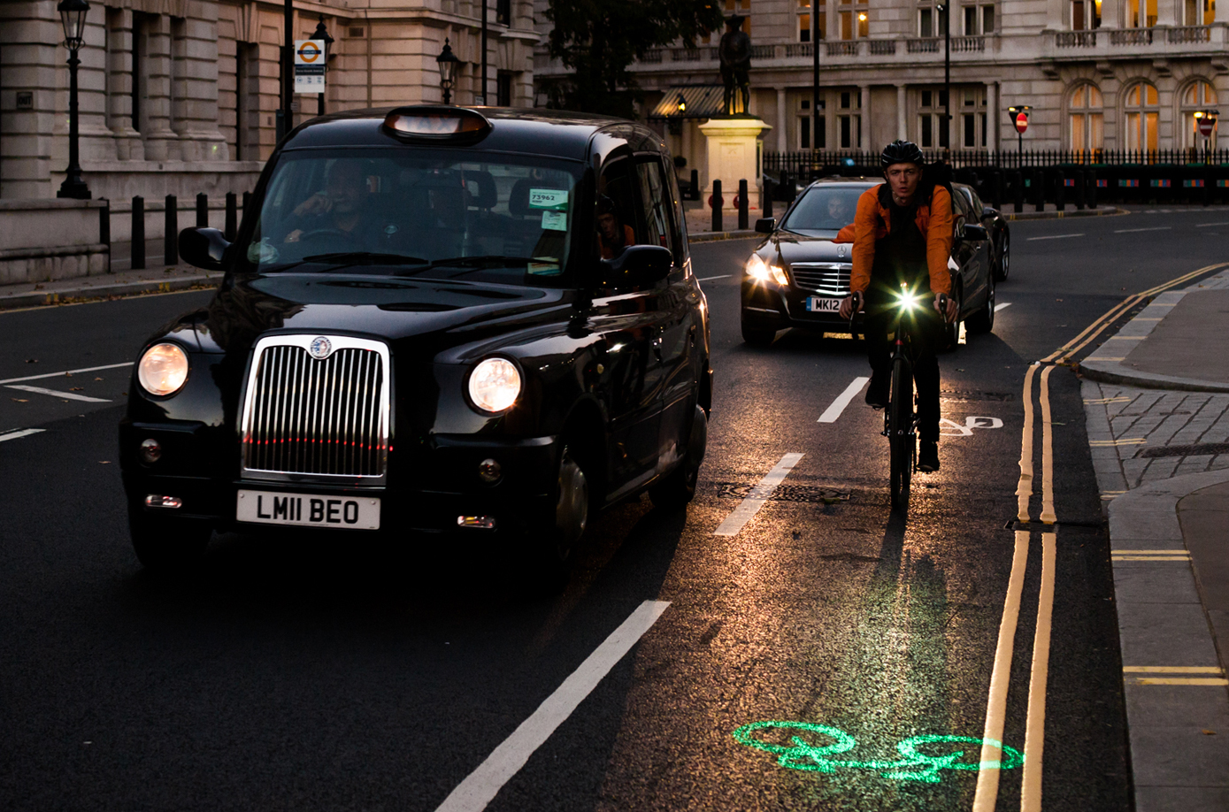
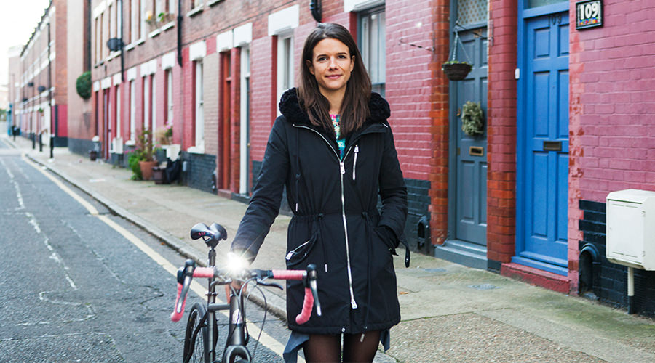
Blaze
Who are they?
Blaze are an urban cycling design company focusing on their mission
of making urban cycling more accessible and safer for as many people
as possible.
Blaze Laserlight Promotional Image
When were they established?
Blaze was created after the success of the founder’s, Emily Brooke, Kickstarter for their original product, the Laserlight, in 2012.
Blaze Founder and CEO, Emily Brooke

Slide 3
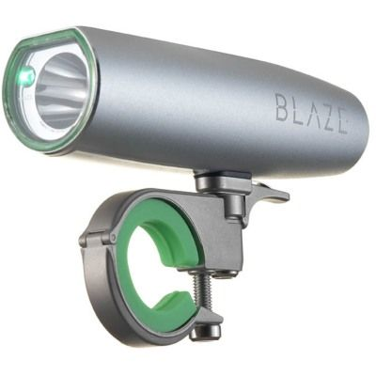
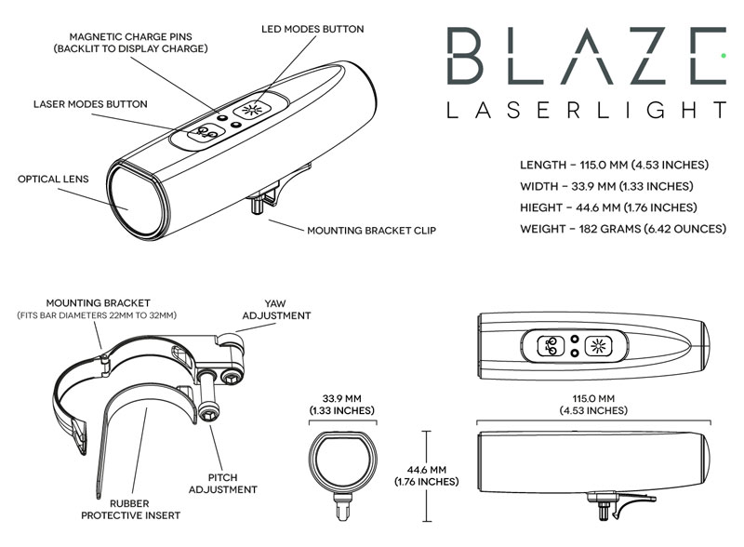
Blaze
The Laserlight
Blaze was founded after the success of their flagship product, the Laserlight, attracted great popularity on Kickstarter.
The Laserlight was the final-year university project of Emily Brook who identified a major problem with cyclists being involved in accidents due to blind spots and wondered if it were possible to “project yourself into view of the driver”.
The result was the Laserlight, a premium bike light with a built in laser to project the image of a bicycle symbol in front of the user.
The product saw great success on Kickstarter and, following continued popularity after its launch, is now being installed on the Santander Cycles and will be built directly into the new generation of bikes set to replace the current stock.
Blaze Laserlight Promotional Image
Blaze Laserlight Basic Diagram

Slide 4
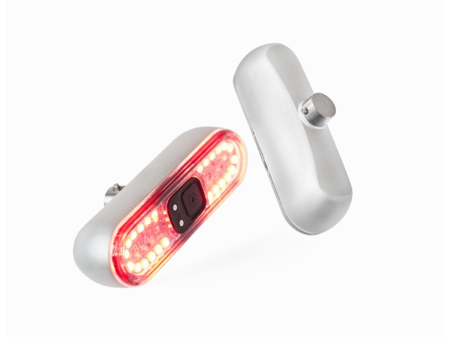
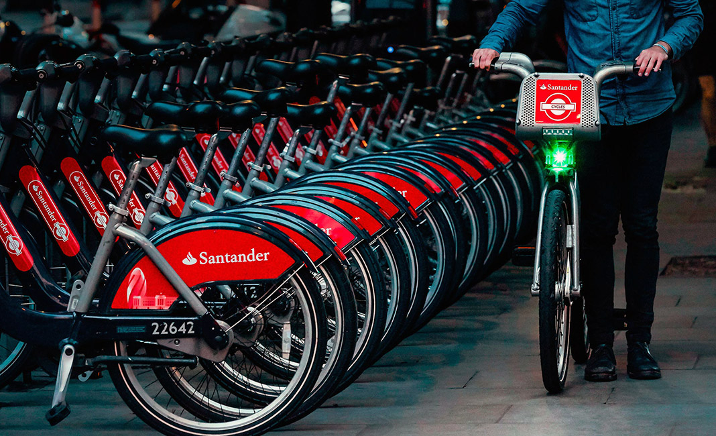
Blaze
The Burner and other products
As explained to us in the visit, the Laserlight utilises a particular diode developed for smartphones with projectors built in and, to pay off development costs, is very expensive meaning that, at least for now, the Laserlight will remain quite expensive.
For this reason, Blaze is looking into lower end safety products, starting with the Burner, a front and rear array of LED’s designed with maximum safety and ease-of-use in mind.
Blaze Burner Promotional Image
During the presentation it was mentioned that other products were in development but that details were a secret.
They are involved in extensive talks and research with Santander and TFL / Cisco about installing data collection and IoT technology in the Laserlight units to help understand how to make journeys safer.
Daniel Barnes, the design director giving most of the talk, talked about how Blaze wishes to stick to their mission of making cycling safer and accessible, mentioning product proposals such as a cycling jacket which were rejected because they strayed to far from the company ethos.
Santander Cycles with Laserlight units installed

